Slide 1
CSS
25-Apr-18
Appendix
Online

Slide 2
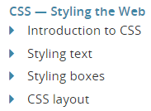
CSS
1
2
3
4
Mozilla Online
https://developer.mozilla.org/en-US/docs/Learn/CSS

Slide 3
CSS – Styling the Web
Source:

Slide 4
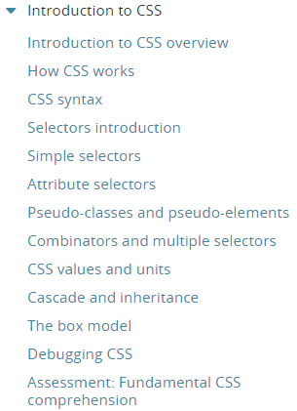
1
Introduction to CSS

Slide 5
Introduction to CSS overview
CSS is used to style and lay out web pages — for example, to alter the font, colour, size and spacing of your content, split it into multiple columns, or add animations and other decorative features.
This module gets you started on the path to CSS mastery with the basics of
how it works
including selectors and properties
writing CSS rules
applying CSS to HTML,
how to specify length, colour, and other units in CSS
cascade and inheritance
debugging CSS

Slide 6
Prerequisites
Before starting this module, you should have:
Basic familiarity with using computers, and using the Web passively (i.e. just looking at it, consuming the content.)
A basic work environment set up as detailed in Installing basic software, and an understanding of how to create and manage files, as detailed in Dealing with files.
Basic familiarity with HTML, as discussed in the Introduction to HTML module.

Slide 7
Guides
This module contains the following articles, which will take you through all the basic theory of CSS, and provide ample opportunity for you to test out some skills.
How CSS works: In this module we start off with a theoretical grounding, looking at what CSS is, how the browser turns HTML into a DOM, how CSS is applied to parts of the DOM, some very basic syntax examples, and what code is used to actually include our CSS in our web page.
CSS syntax: Next up, we dive into CSS syntax in a lot more detail, looking at how properties and their values form into declarations, multiple declarations form into declaration blocks, and declaration blocks and selectors form into complete CSS rules.
We round off the article by looking at other CSS syntax features such as comments and whitespace.
Selectors: Selectors are mentioned in the previous article, but in this guide we go into a lot more detail, showing what selector types are available and how they work.
CSS values and units: There are many types of CSS property values to consider, from numerical values to colors to functions that perform a certain action (like embedding a background image or rotating an element.)
Some of these rely on particular units for specifying the exact values they are representing — do you want your box to be 30 pixels wide, or 30 centimeters, or 30 ems?
In this guide, we look at more common values like length, colour and simple functions, as well as exploring less common units like degrees, and even unitless numerical values.

Slide 8
Guides |
Cascade and inheritance: CSS has two different but related systems to resolve situations where you have selector conflicts (different selectors select the same elements; which one wins and ends up being applied?) and elements nested inside other elements (some of the styling applied to the parent elements makes sense to be inherited by the child elements; some doesn't.)
This article covers both systems in enough detail to be useful but not overwhelming.
The box model: The CSS box model is the foundation of layout on the Web — each element is represented as a rectangular box, with the box's content, padding, border, and margin built up around one another like the layers of an onion.
As a browser renders a web page, it works out what styles are applied to the content of each box, how big the surrounding onion layers are, and where the boxes sit in relation to one another.
Before understanding how to create CSS layouts, you need to understand the box model.
Debugging CSS: In the final article of this module, we take a look at the basics of debugging CSS, including exploring the CSS applied to a page, and other tools that can help you find errors in your CSS code.

Slide 9
Assessments
The following assessments will test your understanding of the CSS basics covered in the guides above.
Fundamental CSS comprehension: This assessment tests your understanding of the above guides with some carefully crafted exercises.

Slide 10
How CSS works
CSS (Cascading Style Sheets) allows you to create great looking web pages, but how does it work under the hood?
This article explains
what CSS is
how the browser turns HTML into a Document Object Model (DOM)
how CSS is applied to parts of the DOM
some very basic syntax examples
what code is used to actually include our CSS in our web page

Slide 11
What is CSS?
As we have mentioned before, CSS is a language for specifying how documents are presented to users — how they are styled, laid out, etc.
A document is usually a text file structured using a markup language — HTML is the most common markup language, but you will also come across other markup languages such as SVG or XML.
Presenting a document to a user means converting it into a usable form for your audience.
Browsers, like Firefox, Chrome or Internet Explorer, are designed to present documents visually, for example, on a computer screen, projector or printer.

Slide 12
How does CSS affect HTML?
Web browsers apply CSS rules to a document to affect how they are displayed.
A CSS rule is formed from:
A set of properties, which have values set to update how the HTML content is displayed, for example I want my element's width to be 50% of its parent element, and its background to be red.
A selector, which selects the element(s) you want to apply the updated property values to.
For example, I want to apply my CSS rule to all the paragraphs in my HTML document.
A set of CSS rules contained within a stylesheet determines how a webpage should look.
You will learn a lot more about what CSS syntax looks like in the next article of the module — CSS Syntax.

Slide 13
A quick CSS example
The above descriptions may or may not have made sense, so let's make sure things are clear by presenting a quick example.
First of all, let's take a simple HTML document, containing an <h1> and a <p> (notice that a stylesheet is applied to the HTML using a <link> element) as shown in Listing H-1.
Now let's look at a very simple CSS example containing two rules - Listing H-2.
The first rule starts with an h1 selector, which means that it will apply its property values to the <h1> element. It contains three properties and their values (each property/value pair is called a declaration):
The first one sets the text color to blue.
The second sets the background color to yellow.
The third one puts a border around the header that is 1 pixel wide, solid (not dotted, or dashed, etc.), and colored black.
The second rule starts with a p selector, which means that it will apply its property values to the <p> element. It contains one declaration, which sets the text color to red.
In a web browser, the code above would produce the following output - Listing H-3

Slide 14
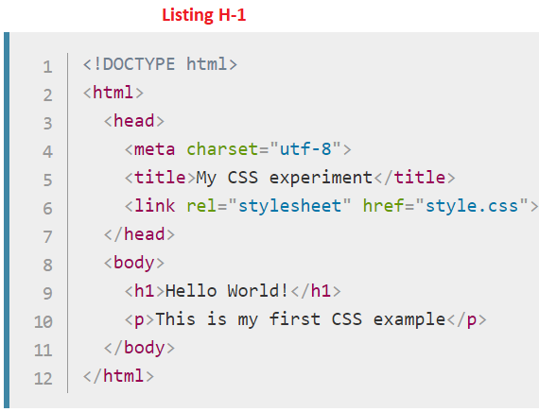
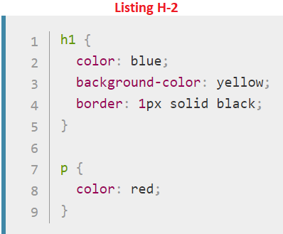
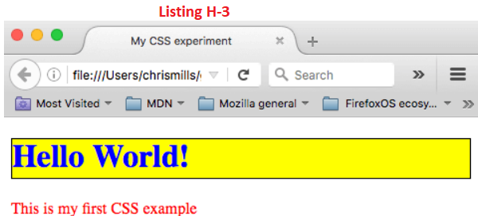
Listing H-1 || H-2 || H-3

Slide 15
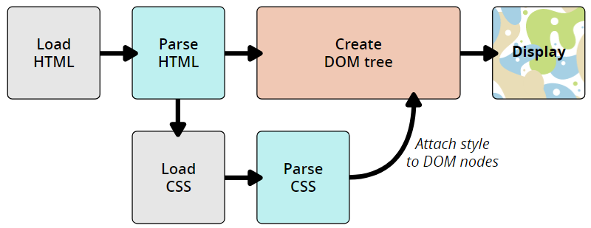
How does CSS actually work?
When a browser displays a document, it must combine the document's content with its style information.
It processes the document in two stages:
The browser converts HTML and CSS into the DOM (Document Object Model).
The DOM represents the document in the computer's memory.
It combines the document's content with its style.
The browser displays the contents of the DOM.

Slide 16
About the DOM
A DOM has a tree-like structure.
Each element, attribute and piece of text in the markup language becomes a DOM node in the tree structure.
The nodes are defined by their relationship to other DOM nodes.
Some elements are parents of child nodes, and child nodes have siblings.
Understanding the DOM helps you design, debug and maintain your CSS because the DOM is where your CSS and the document's content meet up.

Slide 17
DOM representation
Rather than a long, boring explanation, let's take an example to see how the DOM and CSS work together.
Let's assume the HTML code in Listing H-4.
In the DOM, the node corresponding to our <p> element is a parent.
Its children are a text node and the nodes corresponding to our <span> elements.
The SPAN nodes are also parents, with text nodes as their children - Listing H-5.
This is how a browser interprets the previous HTML snippet —it renders the above DOM tree and then outputs it in the browser - Listing H-6

Slide 18
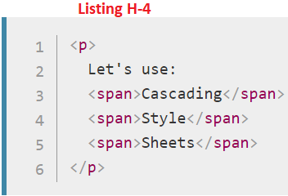
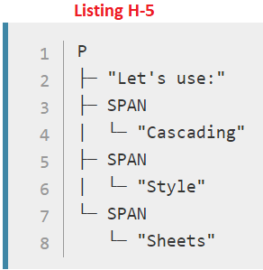
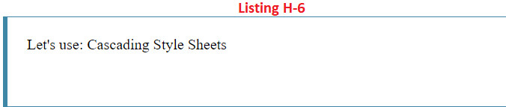
Listing H-4 || H-5 || H-6

Slide 19
Applying CSS to the DOM
Let's say we added some CSS to our document, to style it.
Again, the HTML is shown in Listing H-7.
If we apply the following CSS to it.
The browser will parse the HTML and create a DOM from it, then parse the CSS.
Since the only rule available in the CSS has a span selector, it will apply that rule to each one of the three spans.
The updated output is as shown in Listing H-7

Slide 20
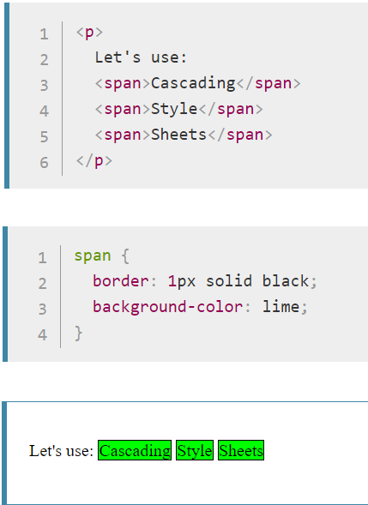
Listing H-7

Slide 21
How to apply your CSS to your HTML

Slide 22
How to apply your CSS to your HTML
There are three different ways to apply CSS to an HTML document that you'll commonly come across, some more useful than others.
Here we'll briefly review each one.
External stylesheet
Internal stylesheet
Inline styles

Slide 23
External stylesheet
You've already seen external stylesheets in this article, but not by that name.
An external stylesheet is when you have your CSS written in a separate file with a .css extension, and you reference it from an HTML <link> element.
The HTML and CSS files looks something like in Listing H-8.
This method is arguably the best, as you can use one stylesheet to style multiple documents, and would only need to update the CSS in one place if changes were needed.

Slide 24
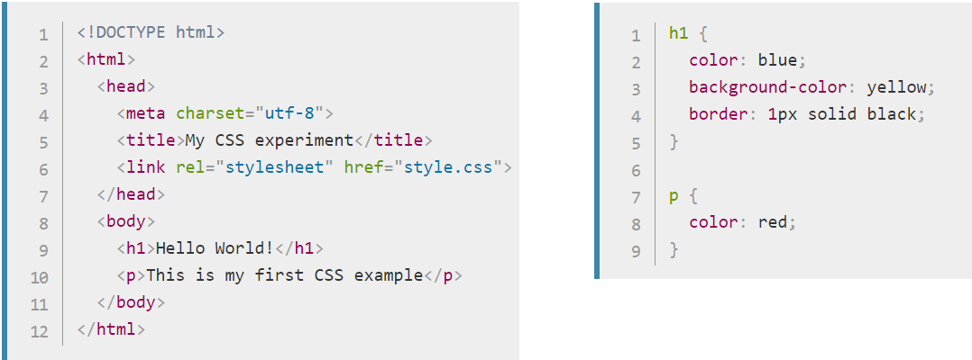
Listing H-8

Slide 25
Internal stylesheet
An internal stylesheet is where you don't have an external CSS file, but instead place your CSS inside a <style> element, contained inside the HTML head.
So the HTML would look like in Listing H-9.
This can be useful in some circumstances (maybe you're working with a content management system where you can't modify the CSS files directly), but it isn't quite as efficient as external stylesheets — in a website, the CSS would need to be repeated across every page, and updated in multiple places if changes were required.

Slide 26
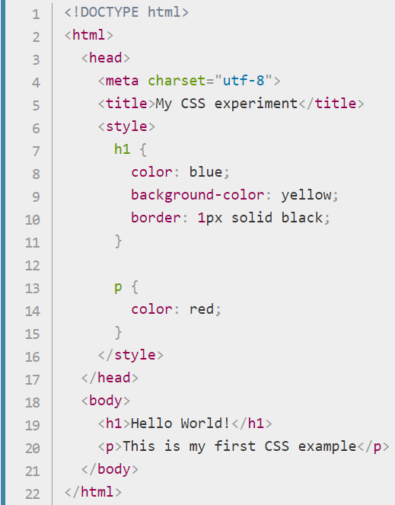
Listing H-9

Slide 27
Inline styles
Inline styles are CSS declarations that affect one element only, contained within a style attribute:
Please don't do this, unless you really have to!
It is really bad for maintenance (you might have to update the same information multiple times per document), and it also mixes your presentational CSS information with your HTML structural information, making the CSS harder to read and understand.
Keeping your different types of code separated and pure makes for a much easier job for all who work on the code.
The only time you might have to resort to using inline styles is when your working environment is really restrictive (perhaps your CMS only allows you to edit the HTML body.)

Slide 28
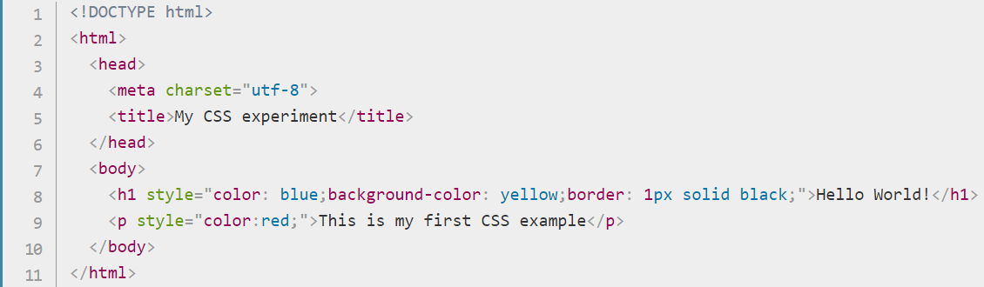
Listing H-10

Slide 29
CSS syntax

Slide 30
Selectors introduction

Slide 31
Simple selectors

Slide 32
Attribute selectors

Slide 33
Pseudo-classes and pseudo-elements

Slide 34
Combinators and multiple selectors

Slide 35
CSS values and units

Slide 36
Cascade and inheritance

Slide 37
The box model

Slide 38
Debugging CSS

Slide 39
Assessment: Fundamental CSS comprehension

Slide 40
Styling text
2

Slide 41
Styling boxes
3

Slide 42
CSS Layout
4

Slide 43
CSS Timeline
CSS History - Wiki

Slide 44
CSS Timeline
On December 17, 1996, W3C published the first standard for CSS.
And thus from December 17, 2016 until one year later, CSS is 20 years old.
The Timeline T-1 shows a pictorial view of CSS release history.

Slide 45
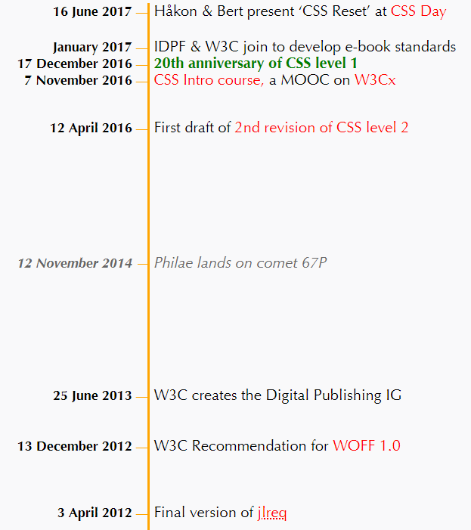
Timeline T-1
7 Apr 18

Slide 46
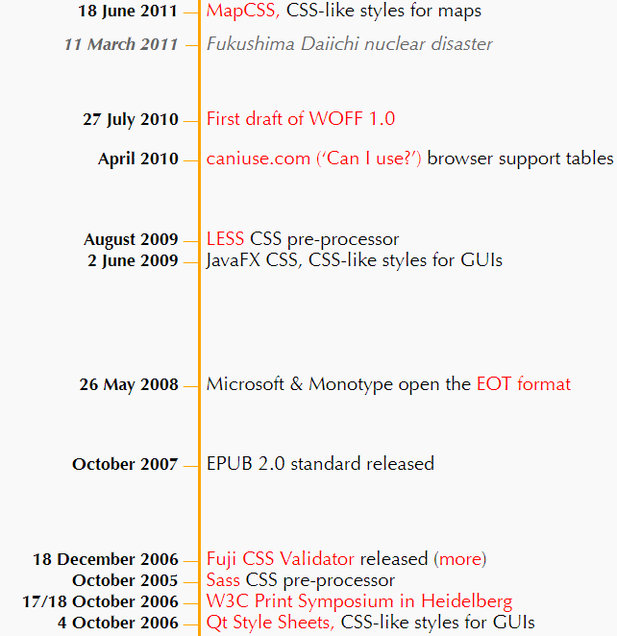
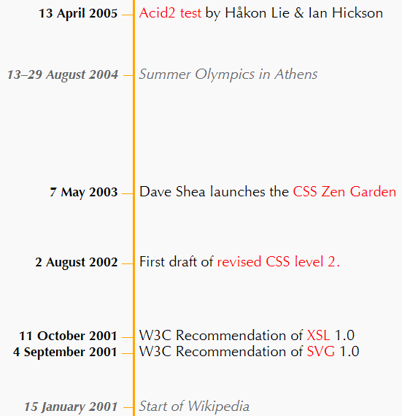
Timeline T-1 |

Slide 47
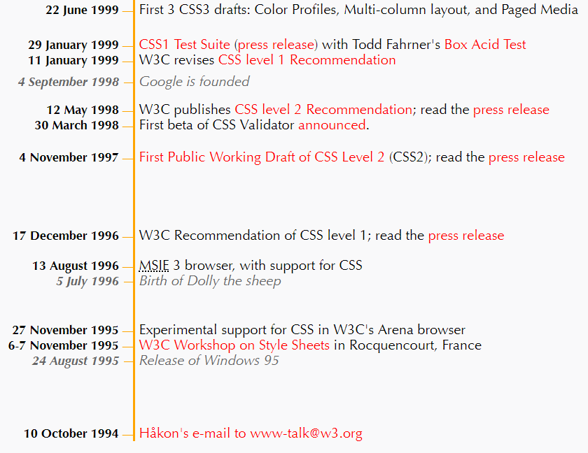
Timeline T-1 |||

Slide 48
CSS History - Wiki
CSS was first proposed by Håkon Wium Lie on October 10, 1994.
CSS has various levels and profiles.
Each level of CSS builds upon the last, typically adding new features and typically denoted as CSS 1, CSS 2, CSS 3, and CSS 4.
Profiles are typically a subset of one or more levels of CSS built for a particular device or user interface.
Currently there are profiles for mobile devices, printers, and television sets.
Profiles should not be confused with media types, which were added in CSS 2.

Slide 49
CSS 1
The first CSS specification to become an official W3C Recommendation is CSS level 1, published on December 17, 1996.
Håkon Wium Lie and Bert Bos are credited as the original developers.
Among its capabilities are support for
Font properties such as typeface and emphasis
Color of text, backgrounds, and other elements
Text attributes such as spacing between words, letters, and lines of text
Alignment of text, images, tables and other elements
Margin, border, padding, and positioning for most elements
Unique identification and generic classification of groups of attributes
The W3C no longer maintains the CSS 1 Recommendation.

Slide 50
CSS 2
CSS level 2 specification was developed by the W3C and published as a recommendation on 12 May 1998.
A superset of CSS 1, CSS 2 includes a number of new capabilities like absolute, relative, and fixed positioning of elements and z-index, the concept of media types, support for aural style sheets (which were later replaced by the CSS 3 speech modules) and bidirectional text, and new font properties such as shadows.
The W3C no longer maintains the CSS 2 recommendation.

Slide 51
CSS 2.1
CSS level 2 revision 1, often referred to as "CSS 2.1", fixes errors in CSS 2, removes poorly supported or not fully interoperable features and adds already implemented browser extensions to the specification.
To comply with the W3C Process for standardizing technical specifications, CSS 2.1 went back and forth between Working Draft status and Candidate Recommendation status for many years.
CSS 2.1 first became a Candidate Recommendation on February 25, 2004, but it was reverted to a Working Draft on June 13, 2005 for further review.
It returned to Candidate Recommendation on 19 July 2007 and then updated twice in 2009.
However, because changes and clarifications were made, it again went back to Last Call Working Draft on 7 December 2010.
CSS 2.1 went to Proposed Recommendation on 12 April 2011.
After being reviewed by the W3C Advisory Committee, it was finally published as a W3C Recommendation on 7 June 2011.
CSS 2.1 was planned as the first and final revision of level 2—but low priority work on CSS 2.2 began in 2015.

Slide 52
CSS 3
Unlike CSS 2, which is a large single specification defining various features, CSS 3 is divided into several separate documents called "modules".
Each module adds new capabilities or extends features defined in CSS 2, preserving backward compatibility.
Work on CSS level 3 started around the time of publication of the original CSS 2 recommendation.
The earliest CSS 3 drafts were published n 22 June 1999.
Due to the modularization, different modules have different stability and statuses
As of June 2012, there are over fifty CSS modules published from the CSS Working Group., and four of these have been published as formal recommendations:
2012-06-19: Media Queries 2011-09-29: Namespaces
2011-09-29: Selectors Level 3 2011-06-07: Color
Some modules have Candidate Recommendation (CR) status and are considered moderately stable. At CR stage, implementations are advised to drop vendor prefixes.
The Summary of main module-specifications in CSS 3 is shown in Figure W-1, W-2.

Slide 53
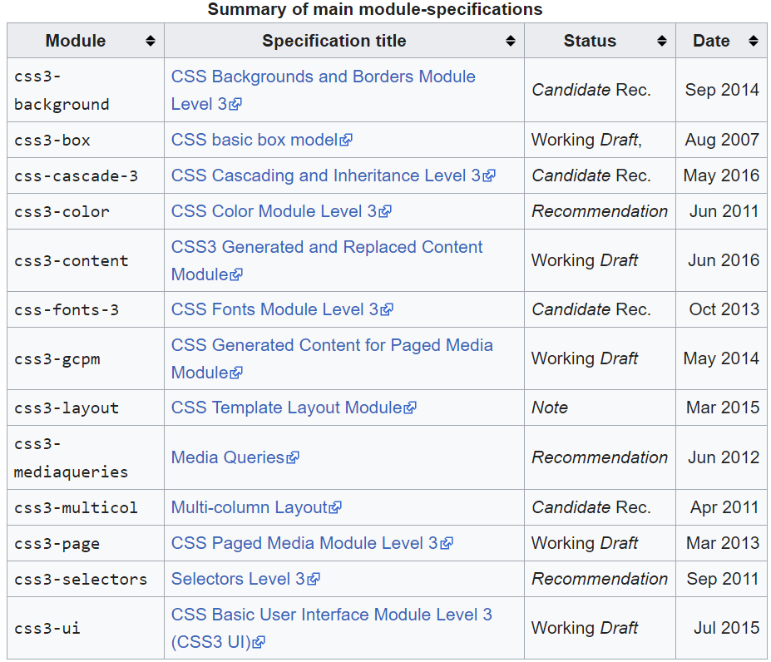
Figure W-1

Slide 54
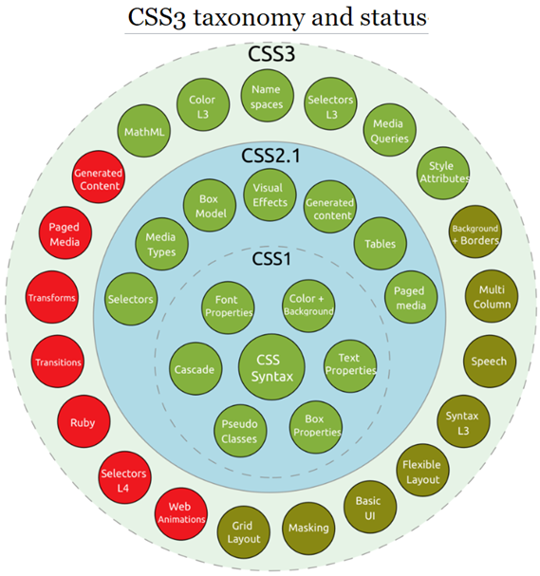
Figure W-2

Slide 55
CSS 4
There is no single, integrated CSS4 specification, because it is split into separate "level 4" modules.
Because CSS3 split the CSS language's definition into modules, the modules have been allowed to level independently.
Most modules are level 3—they build on things from CSS 2.1.
A few level-4 modules exist (such as Image Values, Backgrounds & Borders,[51] or Selectors), which build on the functionality of a preceding level-3 module.
Other modules defining entirely new functionality, such as Flexbox, have been designated as "level 1".
The CSS Working Group sometimes publishes "Snapshots", a collection of whole modules and parts of other drafts that are considered stable, interoperably implemented and hence ready to use.
So far, four such best current practices document have been published as Notes, in 2007, 2010, 2015 and 2017.

